Slide 1

Catwalk 21 Salon & Spa
© Catwalk 21 Salon & Spa

Slide 2
Index
Hair Care
Cuts
Fantasy Styling
Texture
Colouring
Hair Spa
Hair Treatments
Skin Care
Waxing
Threading
De-Tan Premium
Peel Off Masks
Face Masks
Clean – Ups
Express Fruit Facials
Facial Essential
Facial Premium
Facial Signature

Slide 3
Index
Hands & Feet
Foot Spa
Hand Spa
Nail Care
Spa
Head Massage
Quick Massage
Body Spa
Body Polish
Make Up
Bridal
Treatments

Slide 4
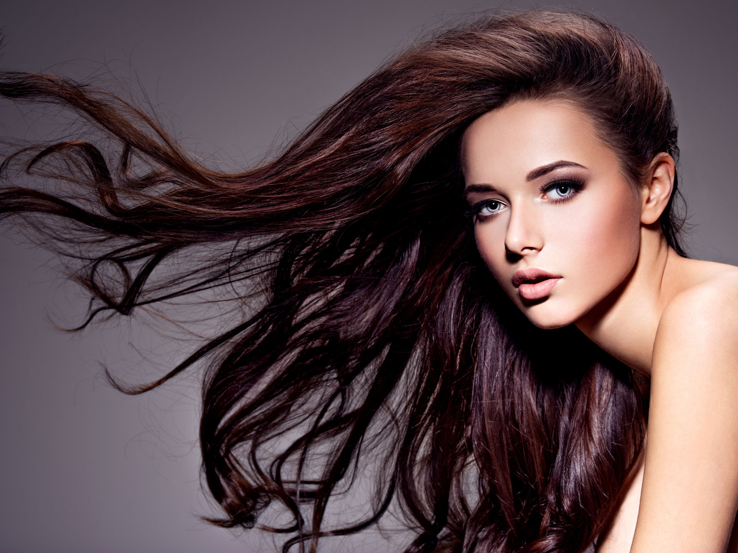
Hair Care

Slide 5

Cuts
Kids Hair Cut (Below 12 yrs) | ₹275
Basic Hair Cut (With Shampoo + Conditioning + Straight Blow Dry) | ₹500
Advance Hair Cut | ₹800
Fringe Cut | ₹350

Slide 6
Fantasy Styling
Hair Wash & Blast Dry | ₹350
Straight Blow Dry (With Shampoo + Conditioning)
Short (Upto Shoulder) | ₹400
Medium (Upto Elbow) | ₹430
Long (Upto Waist) | ₹450
Extra Long (Below Waist) | ₹475
Blow Dry Setting (With Shampoo + Conditioning)
Short (Upto Shoulder) | ₹600
Medium (Upto Elbow) | ₹650
Long (Upto Waist) | ₹700
Extra Long (Below Waist) | ₹750
Crimping
Short (Upto Shoulder) | ₹650
Medium (Upto Elbow) | ₹750
Long (Upto Waist) | ₹850
Extra Long (Below Waist) | ₹950

Slide 7
Fantasy Styling
Ironing (With Shampoo + Conditioning)
Short (Upto Shoulder) | ₹650
Medium (Upto Elbow) | ₹750
Long (Upto Waist) | ₹850
Extra Long (Below Waist) | ₹950
Tongs / Roller Setting (With Shampoo + Conditioning)
Short (Upto Shoulder) | ₹750
Medium (Upto Elbow) | ₹850
Long (Upto Waist) | ₹950
Extra Long (Below Waist) | ₹1050
Hair Up Do Classic
Short (Upto Shoulder) | ₹850
Medium (Upto Elbow) | ₹950
Long (Upto Waist) | ₹1050
Extra Long (Below Waist) | ₹1150

Slide 8
Fantasy Styling
Hair Up Do Advance
Short (Upto Shoulder) | ₹1050
Medium (Upto Elbow) | ₹1150
Long (Upto Waist) | ₹1450
Extra Long (Below Waist) | ₹1750

Slide 9
Texture
Perming
Short (Upto Shoulder) | ₹3300
Medium (Upto Elbow) | ₹4300
Long (Upto Waist) | ₹5300
Extra Long (Below Waist) | ₹6300
Straightening / Smoothening
Short (Upto Shoulder) | ₹3700
Medium (Upto Elbow) | ₹5700
Long (Upto Waist) | ₹7000
Extra Long (Below Waist) | ₹8500
Rebonding
Short (Upto Shoulder) | ₹5500
Medium (Upto Elbow) | ₹7500
Long (Upto Waist) | ₹9500
Extra Long (Below Waist) | ₹11000

Slide 10
Texture
Keratin
Short (Upto Shoulder) | ₹6000
Medium (Upto Elbow) | ₹8000
Long (Upto Waist) | ₹9500
Extra Long (Below Waist) | ₹11000

Slide 11
Colouring
Root Touch Up
1 inch | ₹1000
2 inches | ₹1300
Root Touch Up (Ammonia Free)
1 inch | ₹1000
2 inches | ₹1500
Global Colour
Short (Upto Shoulder) | ₹1700
Medium (Upto Elbow) | ₹2500
Long (Upto Waist) | ₹3200
Extra Long (Below Waist) | ₹3800
Global Colour (Ammonia Free)
Short (Upto Shoulder) | ₹2400
Medium (Upto Elbow) | ₹3300
Long (Upto Waist) | ₹4200
Extra Long (Below Waist) | ₹4800

Slide 12
Colouring
Global Highlights
Short (Upto Shoulder) | ₹2400
Medium (Upto Elbow) | ₹3300
Long (Upto Waist) | ₹4200
Extra Long (Below Waist) | ₹4800
Partial / Crown Highlights
Short (Upto Shoulder) | ₹1300
Medium (Upto Elbow) | ₹1800
Long (Upto Waist) | ₹2300
Extra Long (Below Waist) | ₹2800
Ombre / Ballayage Fashion Colour
Short (Upto Shoulder) | ₹2900
Medium (Upto Elbow) | ₹3900
Long (Upto Waist) | ₹5400
Extra Long (Below Waist) | ₹6400
Classic Fashion Streak (per streak) | ₹250
Advance Fashion Streak (per streak includes prelightening) | ₹550

Slide 13
Hair Spa
Repairing Hairspa (For Extremely Damaged Hair)
Short (Upto Shoulder) | ₹1350
Medium (Upto Elbow) | ₹1550
Long (Upto Waist) | ₹1750
Extra Long (Below Waist) | ₹1950
Smoothening Hairspa (For Dry and Fizzy Hair)
Short (Upto Shoulder) | ₹1350
Medium (Upto Elbow) | ₹1550
Long (Upto Waist) | ₹1750
Extra Long (Below Waist) | ₹1950
Vitalising Hairspa (For Chemically Treated Hair)
Short (Upto Shoulder) | ₹1350
Medium (Upto Elbow) | ₹1550
Long (Upto Waist) | ₹1750
Extra Long (Below Waist) | ₹1950

Slide 14
Hair Spa
Nourishing Hairspa (For All Hair Types)
Short (Upto Shoulder) | ₹1350
Medium (Upto Elbow) | ₹1550
Long (Upto Waist) | ₹1750
Extra Long (Below Waist) | ₹1950
Colour Brilliance Hairspa (Colour Enhancing and Protecting spa for coloured hair)
Short (Upto Shoulder) | ₹850
Medium (Upto Elbow) | ₹900
Long (Upto Waist) | ₹1000
Extra Long (Below Waist) | ₹1100
Volume Boost Hairspa (Volume Enhancing Spa for fine and limp hair)
Short (Upto Shoulder) | ₹850
Medium (Upto Elbow) | ₹900
Long (Upto Waist) | ₹1000
Extra Long (Below Waist) | ₹1100

Slide 15
Hair Treatments
Balancing Treatment (Scalp Treatment for Oily/Sensitive Scalp)
Short (Upto Shoulder) | ₹1800
Medium (Upto Elbow) | ₹2100
Long (Upto Waist) | ₹2400
Extra Long (Below Waist) | ₹2700
Anti Dandruff Treatment (For Dandruff Issues)
Short (Upto Shoulder) | ₹1800
Medium (Upto Elbow) | ₹2100
Long (Upto Waist) | ₹2400
Extra Long (Below Waist) | ₹2700
Anti Hairfall Treatment (For Weak/Damaged Hair)
Short (Upto Shoulder) | ₹1800
Medium (Upto Elbow) | ₹2100
Long (Upto Waist) | ₹2400
Extra Long (Below Waist) | ₹2700

Slide 16
Hair Treatments
Plex Treatment (Strength Treatment for coloured and chemically treated hair)
Short (Upto Shoulder) | ₹1900
Medium (Upto Elbow) | ₹2300
Long (Upto Waist) | ₹2600
Extra Long (Below Waist) | ₹2900

Slide 17
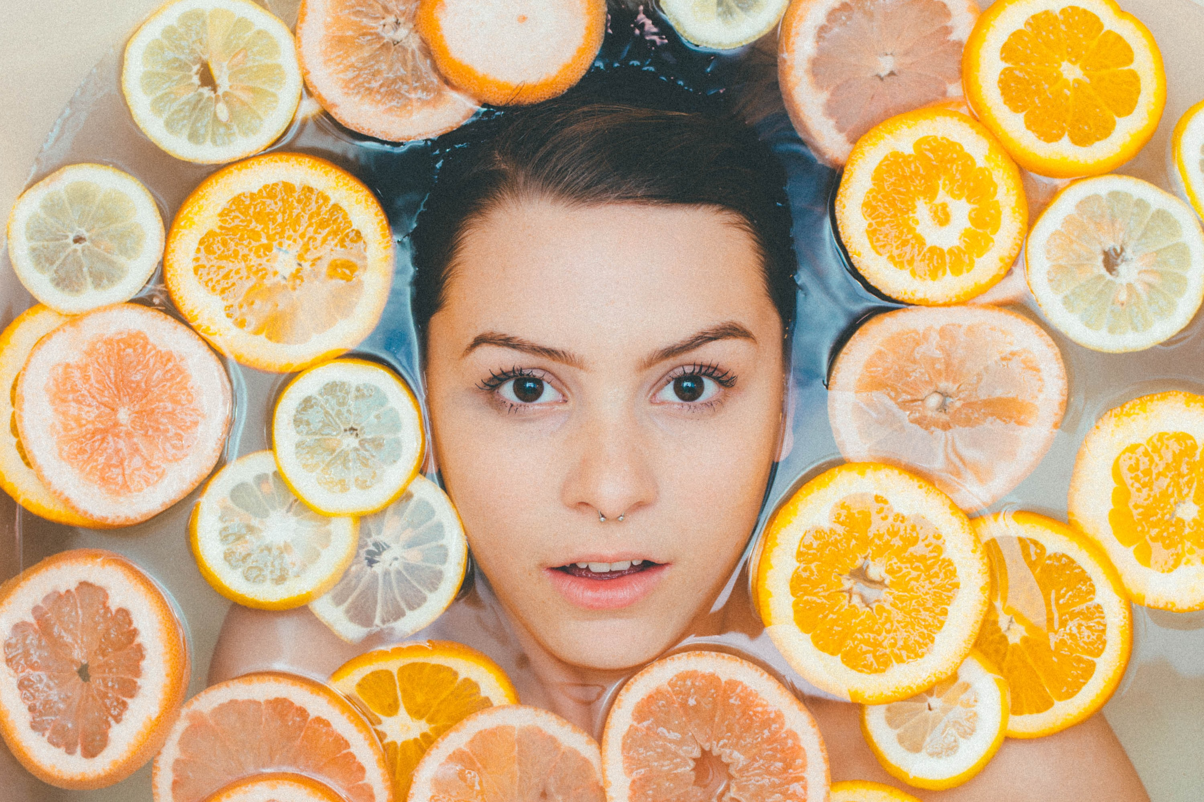
Skin Care

Slide 18
Waxing
Upper Lip
Regular | ₹75
Stripless Wax | ₹150
Chin
Regular | ₹75
Stripless Wax | ₹150
Jawline
Regular | ₹70
Stripless Wax | ₹150
Full Face
Regular | ₹250
Stripless Wax | ₹500
Bikini Line
Regular | ₹250
Stripless Wax | ₹500

Slide 19
Waxing
Brazilian
Regular | ₹1200
Stripless Wax | ₹1700
Buttock
Regular | ₹300
Stripless Wax | ₹450
Under Arms
Regular | ₹70
Flavoured | ₹125
Stripless Wax | ₹200
Half Arms
Regular | ₹175
Flavoured | ₹275
Premium | ₹375

Slide 20
Waxing
Full Arms
Regular | ₹275
Flavoured | ₹375
Stripless Wax | ₹475
Half Legs
Regular | ₹175
Flavoured | ₹375
Premium | ₹525
Full Legs
Regular | ₹375
Flavoured | ₹525
Premium | ₹675
Stomach / Upper Back / Lower Back
Regular | ₹375
Flavoured | ₹575
Premium | ₹725

Slide 21
Waxing
Full Front / Full Back
Regular | ₹525
Flavoured | ₹725
Stripless Wax | ₹1075
Full Body (Excluding Brazilian and Face Wax)
Regular | ₹2450
Flavoured | ₹2950
Premium | ₹3450

Slide 22
Threading
Eyebrow | ₹40
Upperlip | ₹40
Forehead | ₹40
Chin | ₹40
Sides and Jaw Line | ₹100
Face | ₹175

Slide 23
De-Tan Premium
Half Arms | ₹1000
Half Legs | ₹1200
Full Arms | ₹1250
Full Legs | ₹1900
Face and Neck | ₹900
Full Body | ₹3400

Slide 24
Peel Off Masks (20min)
Energy (All Skin Types) | ₹1000
Four Miracle (Pigmented Skin – Win the battle against pigmentation problems) | ₹1000
Four Wonder (Matured Skin – No more laugh lines for you, get firm skin) | ₹1000
Miracle Cool (Oily & Acne Skin – Always wanted a balanced skin texture? Here is the miracle) | ₹1000
Rose Cool (Sensitive Skin – Sensitive skin blossoms into a real cool skin with energy and charm) | ₹1000

Slide 25
Face Masks (20min)
Kavas Mud (Oily Skin – Enhances proper blood circulation and helps natural skin regeneration) | ₹575
U Las (Matured & Aged Skin – Say no to wrinkles, promote soft, toned and healthy skin) | ₹475
Mountain Breeze (Sensitive Skin – Get youthful look with amply moisturized skin) | ₹475
Whitening Mask (All Skin Types – Unmask the glow with clean and bright skin) | ₹700

Slide 26
Clean Ups(30min)
Oxizenate (All Skin Types - Protects the skin from UV rays to give it a porcelain smooth texture) | ₹800
Blueberry Detox (Dry Skin – A butterfly soft and moisturized skin without wrinkles is not a myth and more) | ₹800
Anti Oxidant (Tired Skin – No more tired skin.. rejuvenated skin is the order of the times) | ₹800
Calm & Soothe (Sensitive Skin – Exfoliates clogged skin to give a smooth, soft and lighter skin) | ₹850
Vitamin C (Tanned Skin – Instant glow, brighter look with no skin damage, all this with vitamin C extracts) | ₹1000

Slide 27
Express Fruit Facials(30min)
Water Melon/Strawberry/Black Currant/Chocolate/Papaya/Orange/Mixed Fruit | ₹1100

Slide 28
Facial Essential(45min)
Hydra Dew (Dry & Dehydrated – Moisture and sooth your delicate and dry skin with comfort and protection) | ₹1300
Acne Care (Acne Prone – Regulate your skin imperfections with the anti-microbial ingredients) | ₹1550
Re-Balancing (Oily & Combination – Give your skina Matte finish by regulating, controlling and reducing sebum production) | ₹1650
Rejuvenating (All Skin Type – Revitalize to leave a supple skin by proper exfoliation and enhanced blood circulation) | ₹1800
Deep Pre Cleansing (Olily skin) | ₹2050
Herbal Gold (A natural retreat for your skin from hand picked herbal ingredients) | ₹2300

Slide 29
Facial Premium(75min)
Clarifying Acne (Acne Prone Skin – If you are breakout prone, have clogged pores or blackheads, then pick this. Re-balance and restore skin with this stimulating facial) | ₹2100
Whitening Facial (Dull & Uneven Skin Tone – One of the most effective, fastest and safest approach to skin lightening by reducing Melanin formation. Contains broad spectrum sun filters which minimize photo damage, promote even skin tone and reduce skin tanning on exposure to UV rays) | ₹2500
Hydra Fresh Facial (Dry & Dehydrated Skin - Stimulates collagen formation. Traditional Asian ingredients, pearl & Algae extracts strengthen and tighten the skin and provides protection, hydration and nourishment | ₹2100
Herbal Diamond (Nature’s touch to get a fresh look) | ₹2500

Slide 30
Facial Signature(90min)
Uplifting Facial (Matured Skin – A corrective regimen for dehydrated, ageing, and environmentally challenged skin) | ₹3100
Ultra Bright Facial (Pigmented Skin – This regimen is oriented for inhibition of pigmentation. White tea extracts lightens the skin evenly and reduces the degree of skin tanning and provides radical protection. This retreat includes dual mask) | ₹3100
Herbal Platinum (An organic formula which gives instant results) | ₹3600

Slide 31
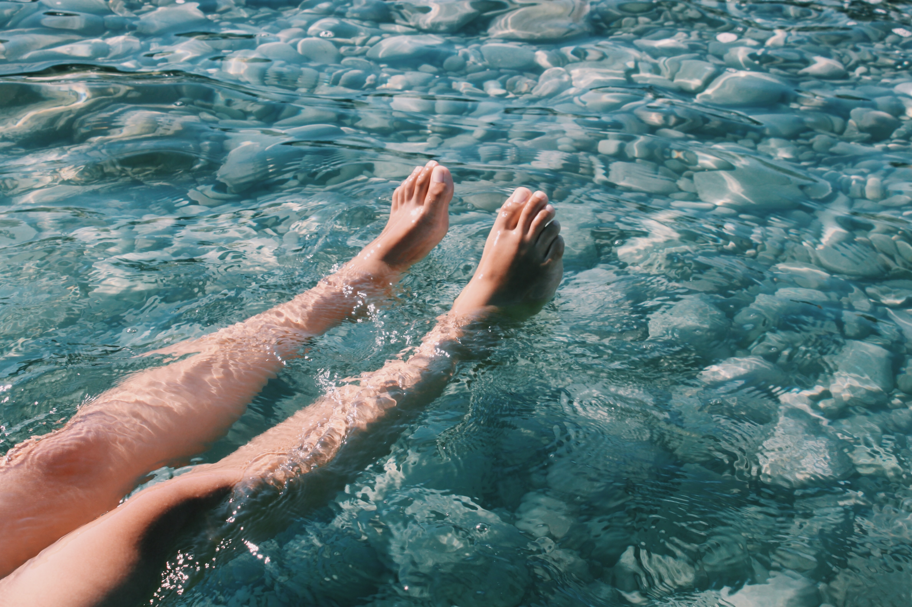
Hands & Feet

Slide 32
Foot Spa
Classic Pedicure (45 min - A relaxing and refreshing regimen for tired legs) | ₹425
French Pedicure (45 min – With a chic French touch for overall relaxation and finishing with application at French polish) | ₹500
Anti Oxidant – Pedicure (45 min – Detoxicating thick ankles and calves) | ₹750
Brightening & De-Tan Pedicure (60 min – Removes tan and gives brighter and smoother feet) | ₹1000
Moisturizing Pedicure (60 min) | ₹1000

Slide 33
Hand Spa
Classic Manicure (30 min – For a profoundly relaxing experience with sublime massage of hands and palms) | ₹375
French Manicure (45 min With a chic French touch for overall relaxation and finishing with application of French polish) | ₹475
Anti Oxidant – Manicure (45 min – Detoxicating thick knuckles and nails) | ₹675
Brightening & De-Tan Manicure (60 min – Removes tan and gives brighter and smoother nails and fingers) | ₹900
Moisturizing Manicure (60 min) | ₹900

Slide 34
Nail Care
Cut, File, Polish (20 min) | ₹125
Change of Polish (10 min) | ₹120

Slide 35
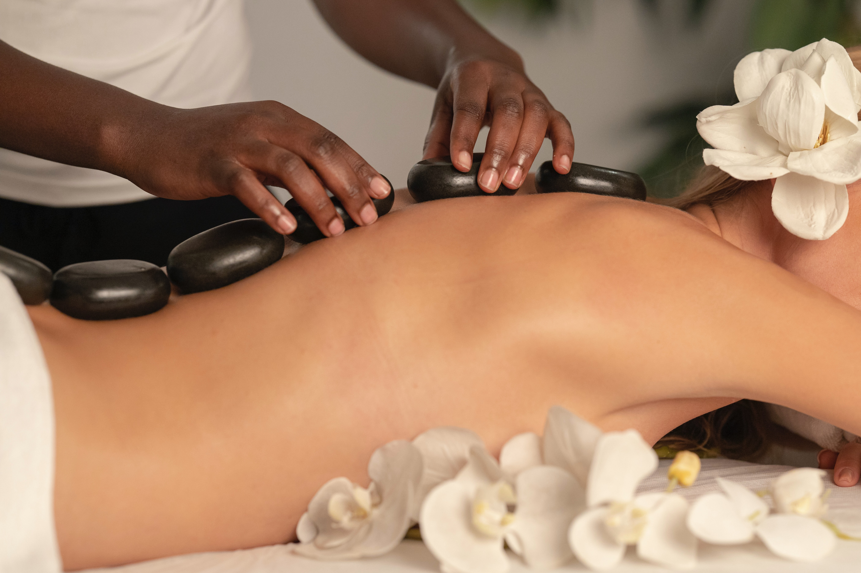
Spa

Slide 36
Head Massage
Scalp Massage (Morrocan Oil) | ₹525
Head Massage (Dry) | ₹225
Head Massage (Coconut Oil) | ₹275
Head Massage (Mint Oil) | ₹375
Head Massage (Aroma Oil) | ₹425
Champi – Herbal Oil (Traditional Indian Head Massage) | ₹375

Slide 37
Quick Massage
Hand Reflexology (20 min – Massaging and stimulating pressure points in hand to release the energy and relax tired hands) | ₹450
Foot Reflexology (30 min) (60 min) (Stimulate and massage pressure points in legs to release the energy and relax tired legs) | ₹550 ₹1000
Back (30 min) | ₹600
Head, Neck & Shoulder (30 min – Relax, de-stress, revive, and renew the body with perfect massage strokes) | ₹600

Slide 38
Body Spa
Swedish Therapy (60 min) (90 min) (Long & Smooth strokes in the direction of the blood flow towards the heart. The therapy increases the oxygen level in the blood, decreases muscle toxins, improves circulation, eases tension & balances the body) | ₹1700 ₹2300
Deep Tissue Therapy (60 min) (90 min) (Focuses on the deepest layers of muscle tissue. Releases chronic muscle tension, relieves deep muscle stiffness and soreness) | ₹1900 ₹2600
Catwalk 21 Signature Therapy (60 min) (90 min) (The application of essential oils helps to improve mental & physical states, release muscle tension, hydrate the skin & provide immediate relaxation) | ₹2100 ₹2800

Slide 39
Body Spa
Balinese (60 min) (90 min) (An Indonesian Traditional Massage Technique that helps to resolve muscle strain, poor flexibility and respiratory problems. Also improves energy levels, stimulates blood flow and reduces stress) | ₹2300 ₹3000
De-stress Therapy (60 min) (90 min) (Thai style combined with European style helps in improving circulation and flexibility, relieves muscle compression, enhances joint mobilization and positive energy flow) | ₹2400 ₹3200
Aroma Relax Therapy (90 min) (The Hawaiian Technique instills a feeling of peace and well-being by rejuvenating the body. Restores physical as well as mental relaxation , relieves nervous system, improves blood circulation & lymph flows, eliminates toxic waste) | ₹3300

Slide 40
Body Polish
Full Body (A popular body regimen that exfoliates and hydrates your skin, leaving it smooth, soft and glowing with a uniform tone across the body) | ₹3300

Slide 41
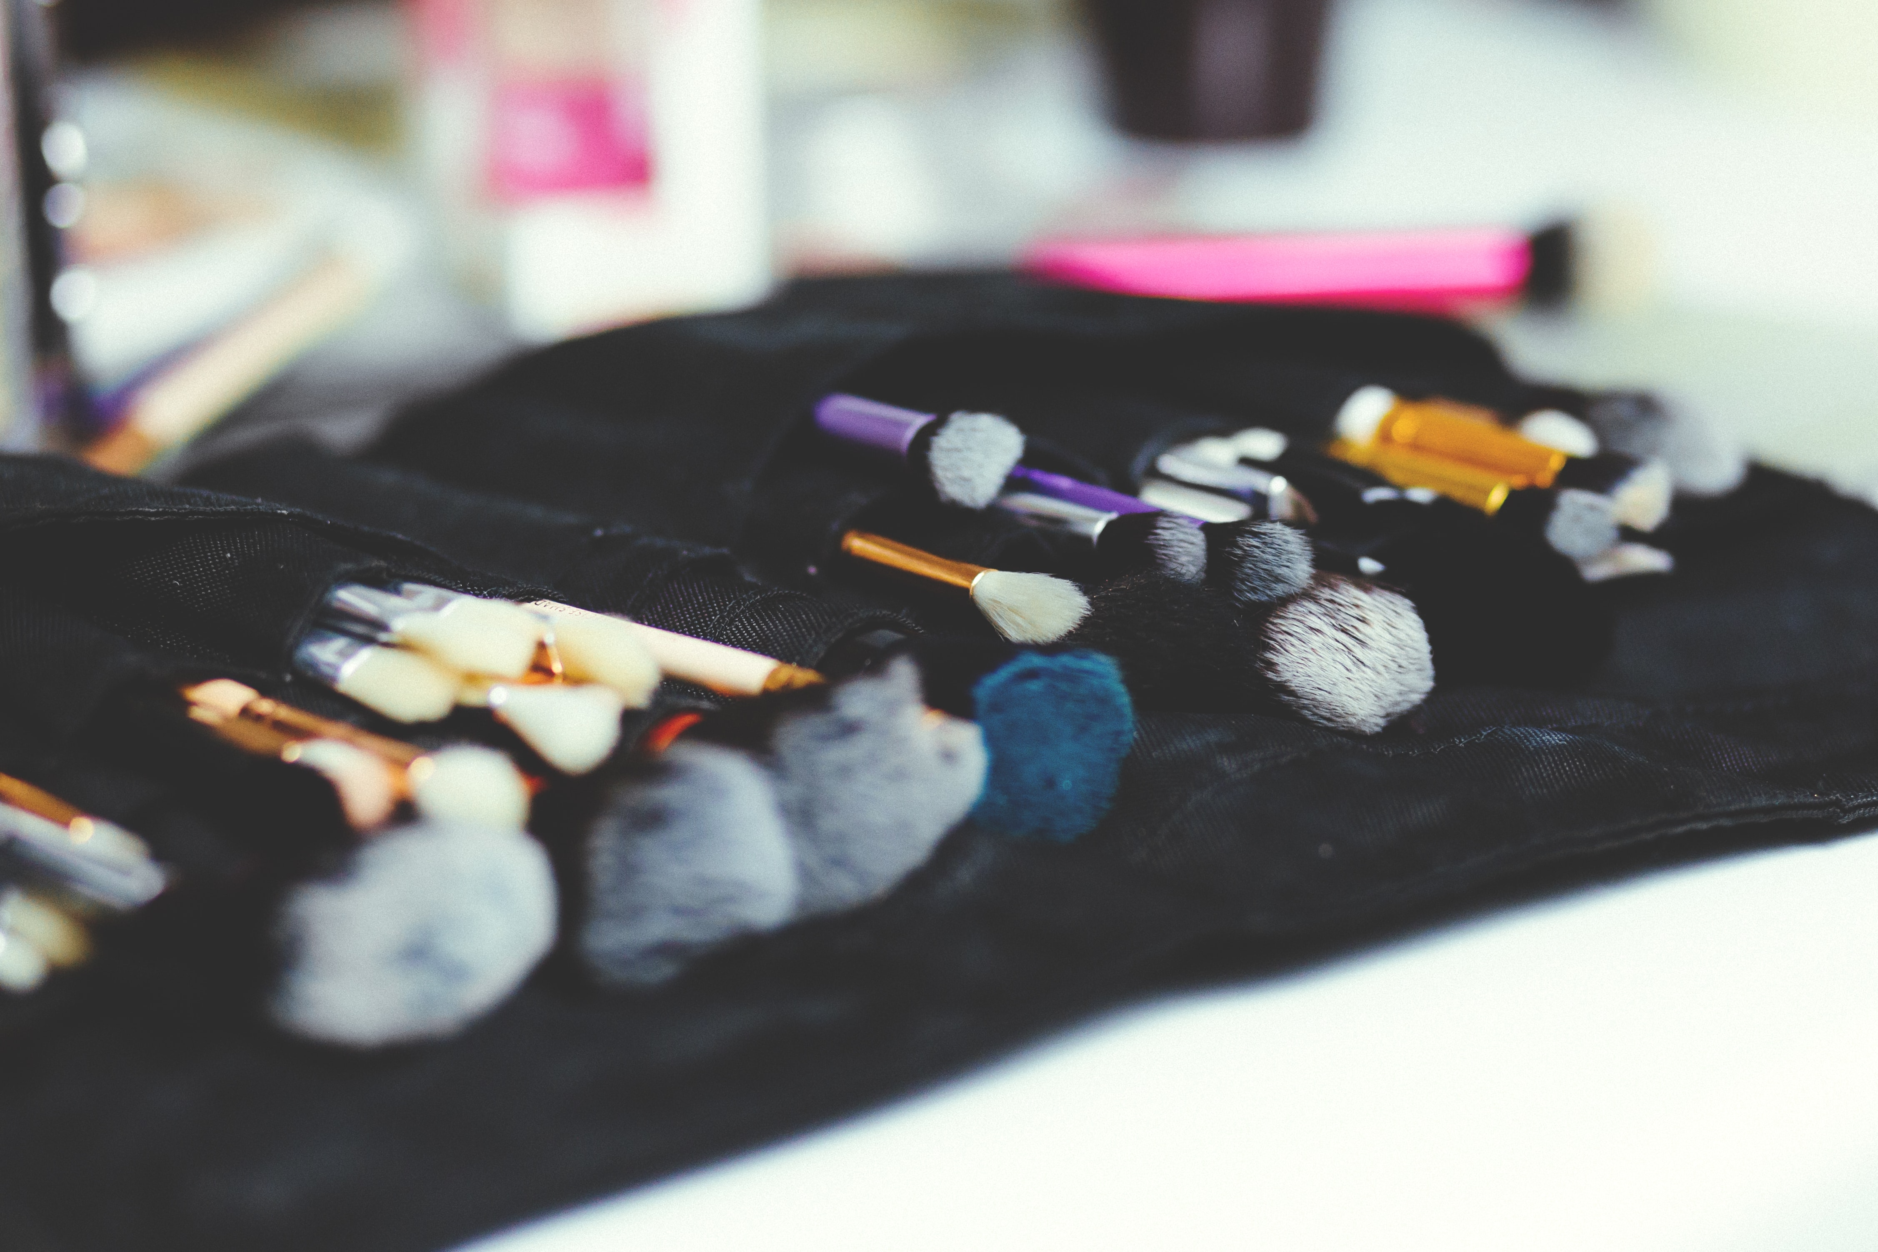
Make Up

Slide 42
Make-Up
Eye Make Up (20 min – Stand out and look stunning with the use of right mascara, eyeliner, eye shadow and long lushy eyelashes) | ₹1300
Light Make Up (30 min – Enhance your natural skin tone with subtle make up, just enough to make one seem naturally beautiful) | ₹2200
Light Make Up (Premium) | ₹3200
Party Make Up (35 min – Party on the mind? Match your make up with your attire and grab all attention) | ₹2500
Party Make Up (Premium) | ₹3500
Fashion Make Up for Photo Shoot (Full Day) (Lights… Camera… Click… Get picture perfect with special fashion make up for photo shoot) | ₹12000

Slide 43
Make-Up
Engagement Make Up (60 min – Look beautiful and graceful in every possible way that every “Bride to be” needs for her special day) | ₹5500
Bridal Make Up | ₹8500
HD Make Up | ₹15000
AirBrush Make Up | ₹15000
Friends & Family of the Bride Make Up (Per person 30 min) | ₹2300
Saree Draping (20 min – Eloquent draping of saree (in any Indian style) to transform one to become graceful, elegant and sensuous woman) | ₹750
Mehandi – Hands (30 min – Expert Mehandi designers use organic Henna to paint intricate designs, from Arabic to traditional that add colour to your life) | ₹1400

Slide 44
Make-Up
Mehandi – Hands & Feet (60 min) | ₹2300
Mehandi – Bridal (90 min) | ₹3200

Slide 45
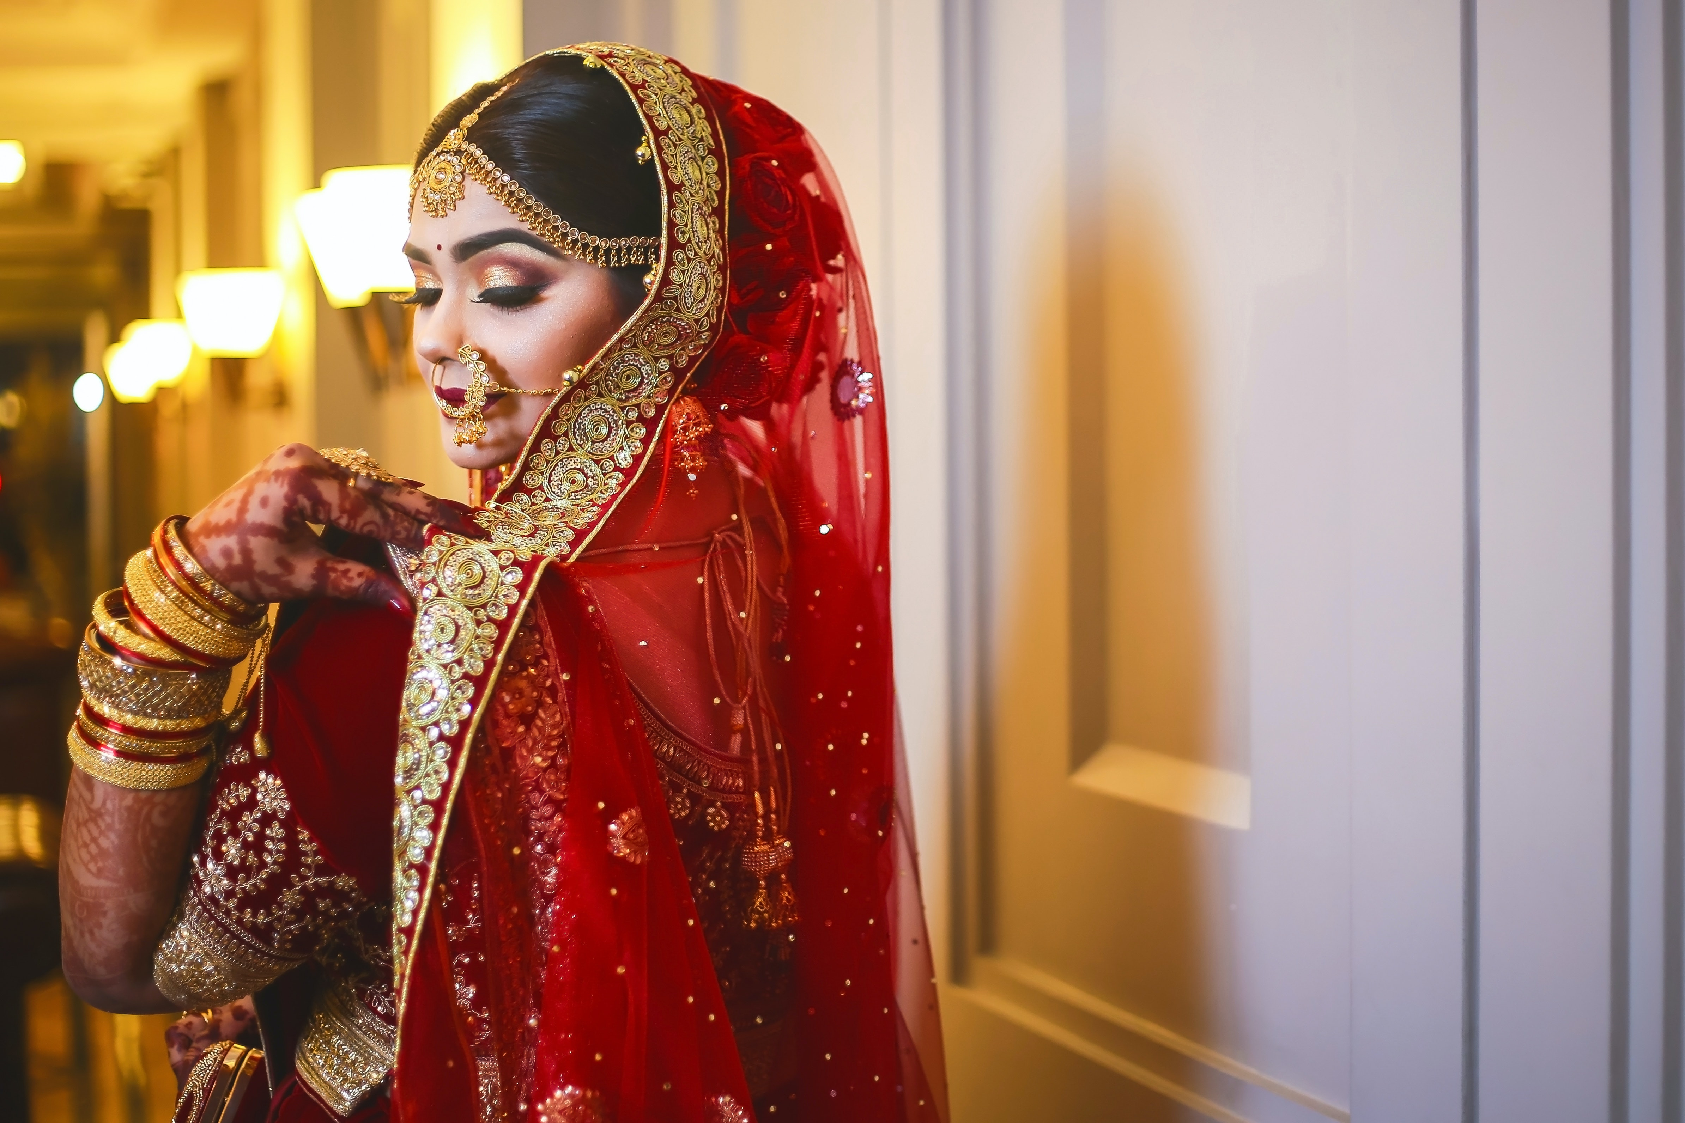
Bridal

Slide 46
Pre-Bridal
Silver Package (1 day) Thereading (Full Face) Waxing (Flavoured – Full Hands & Full Legs) Manicure (Classic) Pedicure (Classic) Nourishing Hairspa Rejuvenating (All Skin Types) Full Body Polishing | ₹6300
Gold Package (3 days) | ₹12500
Day 1 Waxing (Regular full body) Hair Cut Basic Head Massage (Aroma)
Day 2 Body Massage (Aroma Relax) Nourishing Hairspa Manicure Classic Pedicure Classic
Day 3 Premium Facial – Herbal Diamond Full Body Polishing Mehandi – Bridal Hair Wash & Blow Dry

Slide 47
Pre-Bridal
Platinum Package (5 days) | ₹20000
Day 1 Threading (Full Face) Waxing Chocolate (Full Body) Advanced Hair Cut Hair Colour Global – Ammonia Free - Short (Upto Shoulder)
Day 2 Full Body De Tan Clean Up (Vitamin C)
Day 3 Body Massage (Signature) Head Massage – Aroma Oil
Day 4 Manicure – Brightening & De-Tan Pedicure – Brightening & De-Tan Nourishing Hairspa Short (Upto Shoulder)
Day 5 Uplifting Facial (Matured Skin) Body Polish (Full Body) Mehandi - Bridal

Slide 48
Pre-Bridal
Enchanted Bride Package | ₹19500
1st sitting Gold Package
2nd sitting Trial Make Up & Trial Hair Style
3rd sitting Bridal Make Up, Saree Draping, Hair Style
Fairy Tale Bride Package | ₹28000
1st sitting Platinum Package
2nd sitting Trial Make up, Hair Style
Day of Wedding Bridal Make up, Hair Style

Slide 49
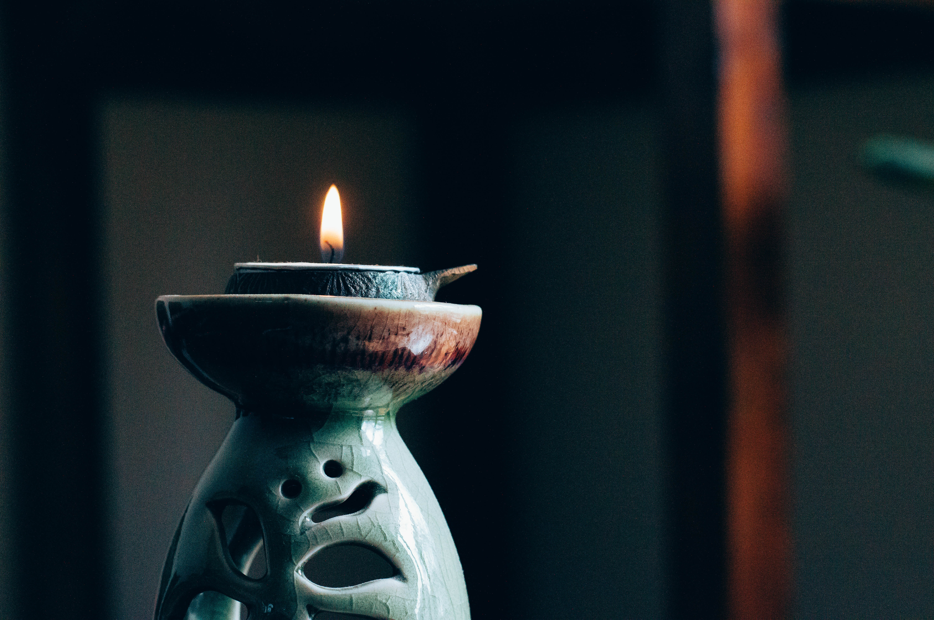
Treatments

Slide 50
Premium Skin Treatment Masks
Gold Collagen (Lightening/Brightening Mask) | ₹1800
Mineral Collagen (Pigmentation/Dark Spots/Tan) | ₹1800
Algae Collagen (Anti Ageing and Fine lines) | ₹1800

Slide 51
Skin Treatments
Anti Acne | ₹4000
Anti Pigmentation | ₹4500
Pore Reduction | ₹5000
Anti Ageing | ₹6000
Under Eye | ₹2500

